Slide 1
Students and Faculty on Their IT Experience and Expectations: 2015 ECAR Findings
D. Christopher Brooks, Senior Research Fellow
@dcbphd
Eden Dahlstrom, Director of Research
@datadeeva
18 November 2015
EDUCAUSE Live!

Slide 2
Roadmap
Project overview
Setting the context
Mobile technologies
Analytics
Wireless infrastructure
New models for education
Future work

Slide 3
Project overview

Slide 4
October 2015
December 2015

Slide 5
Thanks to Our Sponsor
EDUCAUSE
thanks the 2015 student study sponsor!

Slide 6
A series of ECAR studies that research technology experiences and expectations among students, faculty, and other populations of the academic community.

Slide 7
How does this work?
ECAR
Conceptualizes
Operationalizes
Invites
Facilitates
Returns
Analyzes
Reports
Institutions
Volunteer
Implement
Remind
Utilize

Slide 8
ETRAC Research Hub

Slide 9
Poll Question 1
Has your institution participated in the ECAR Student Study or ECAR Faculty Study?
Yes, both
Yes, the Student Study only
Yes, the Faculty Study only
Neither (not yet!)
Don’t know

Slide 10
Setting the context

Slide 11
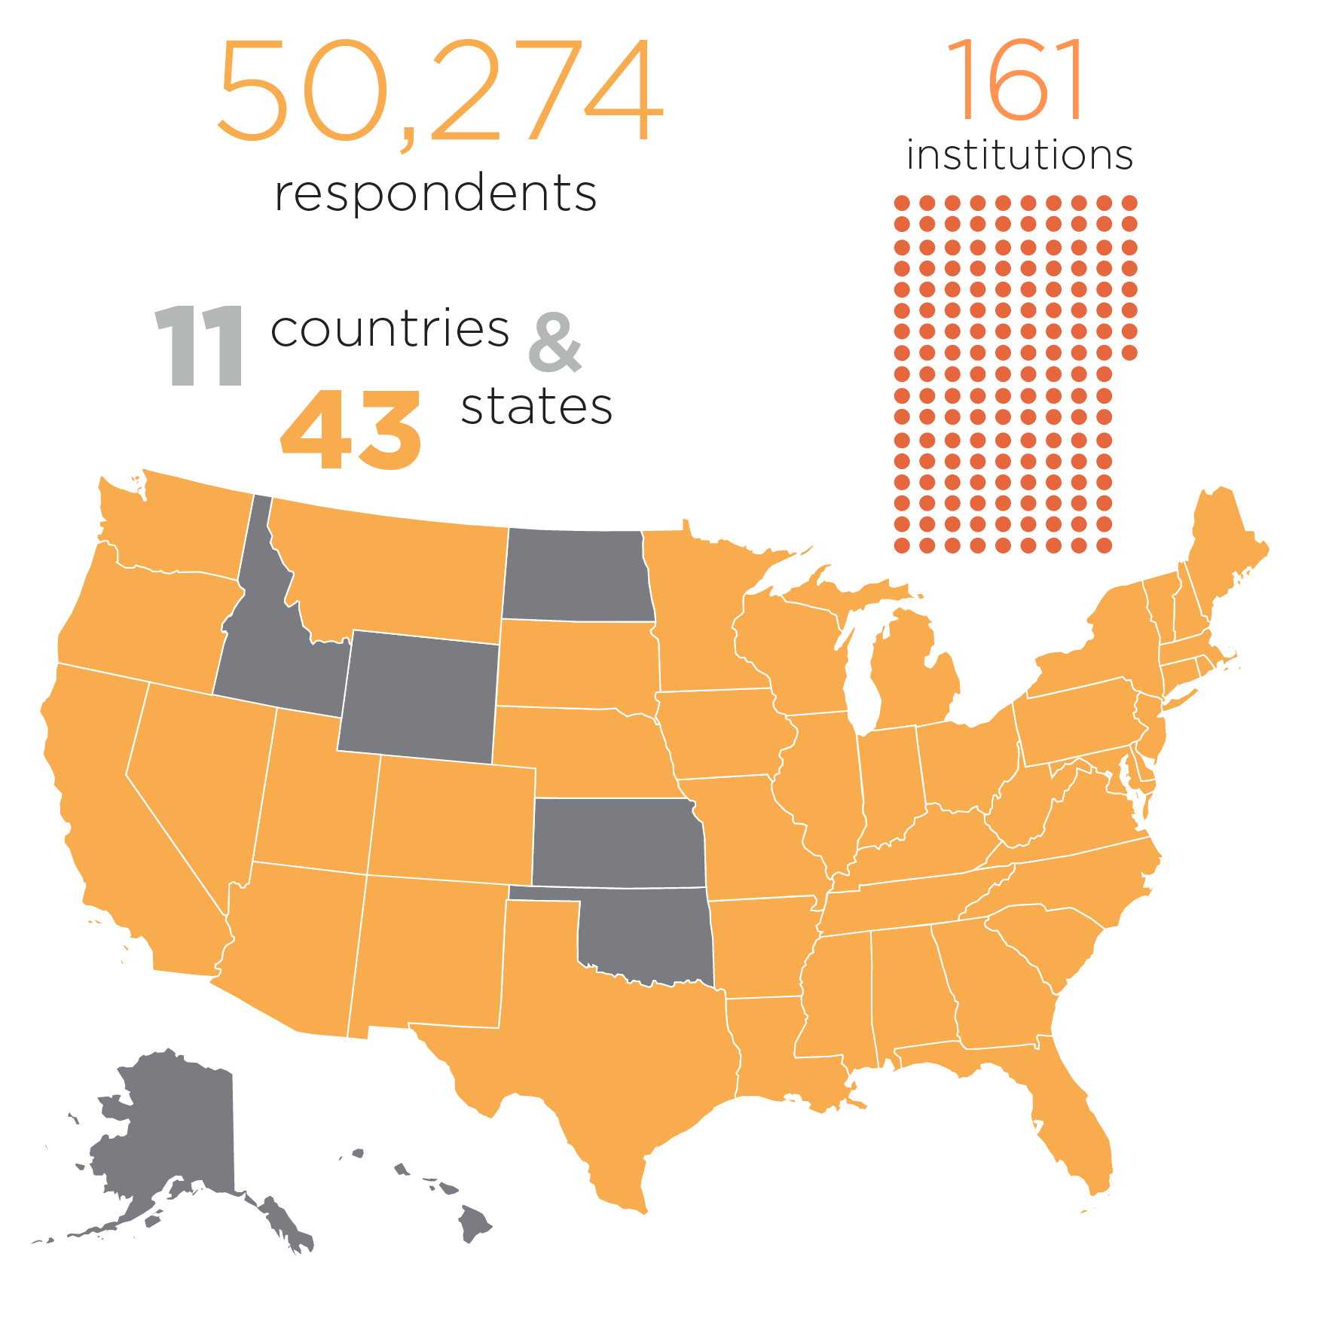
Student study participation overview

Slide 12
Faculty study participation overview

Slide 13
Student and faculty IT orientation

Slide 14
Mobile devices

Slide 15
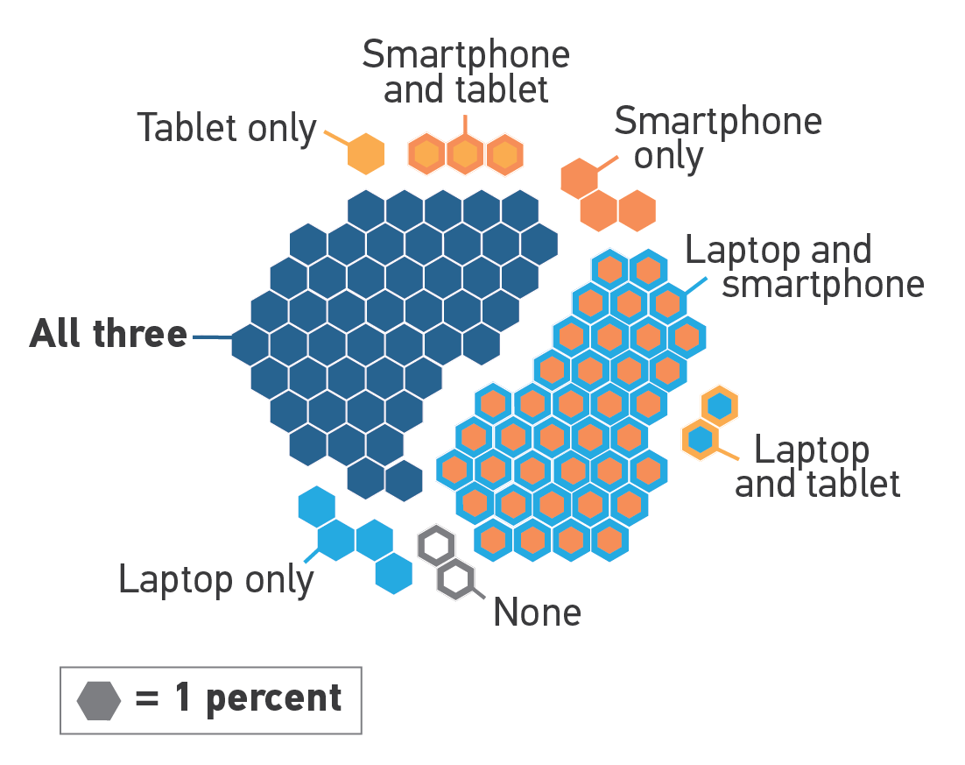
Student device ownership

Slide 16
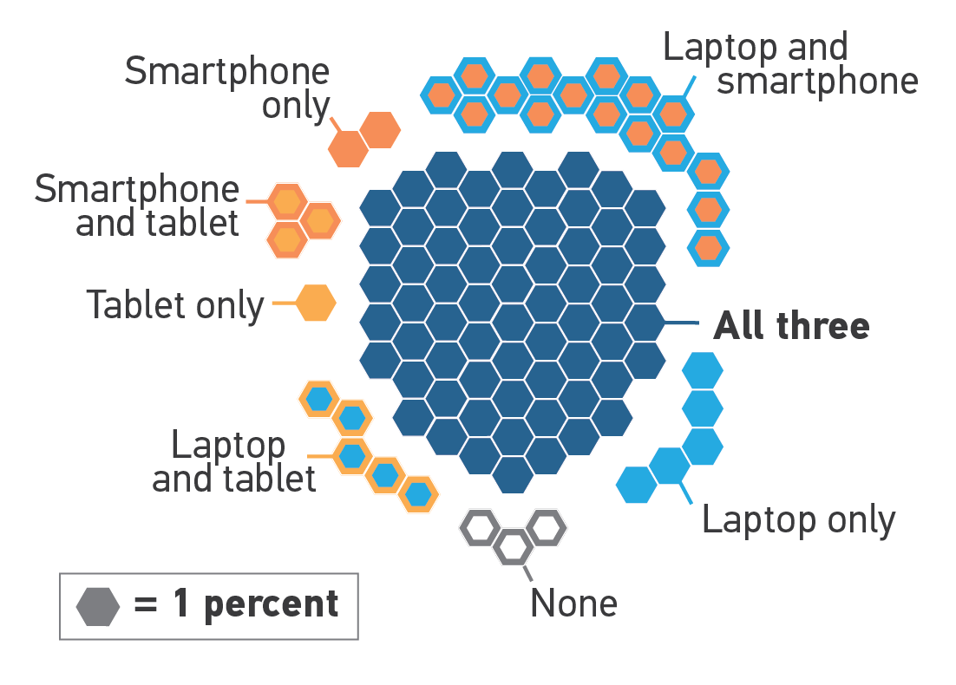
Faculty device ownership

Slide 17
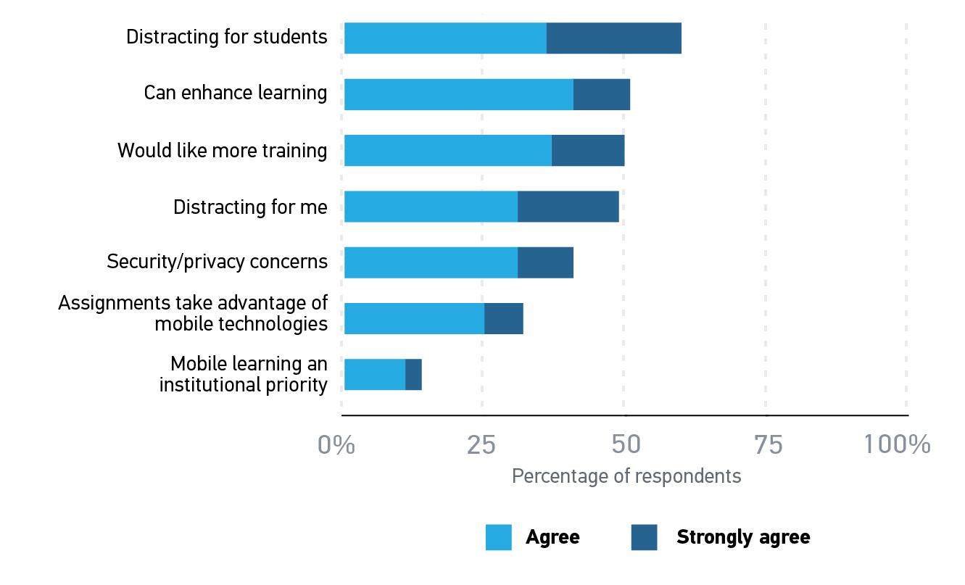
Faculty views on mobile technology in the classroom

Slide 18
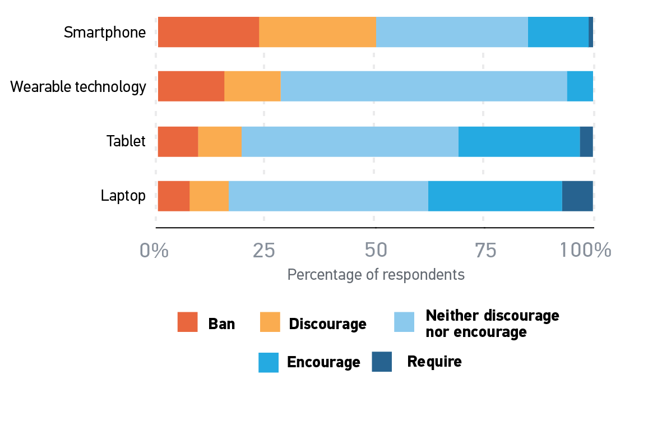
Faculty in-class BYOD policies and practices

Slide 19
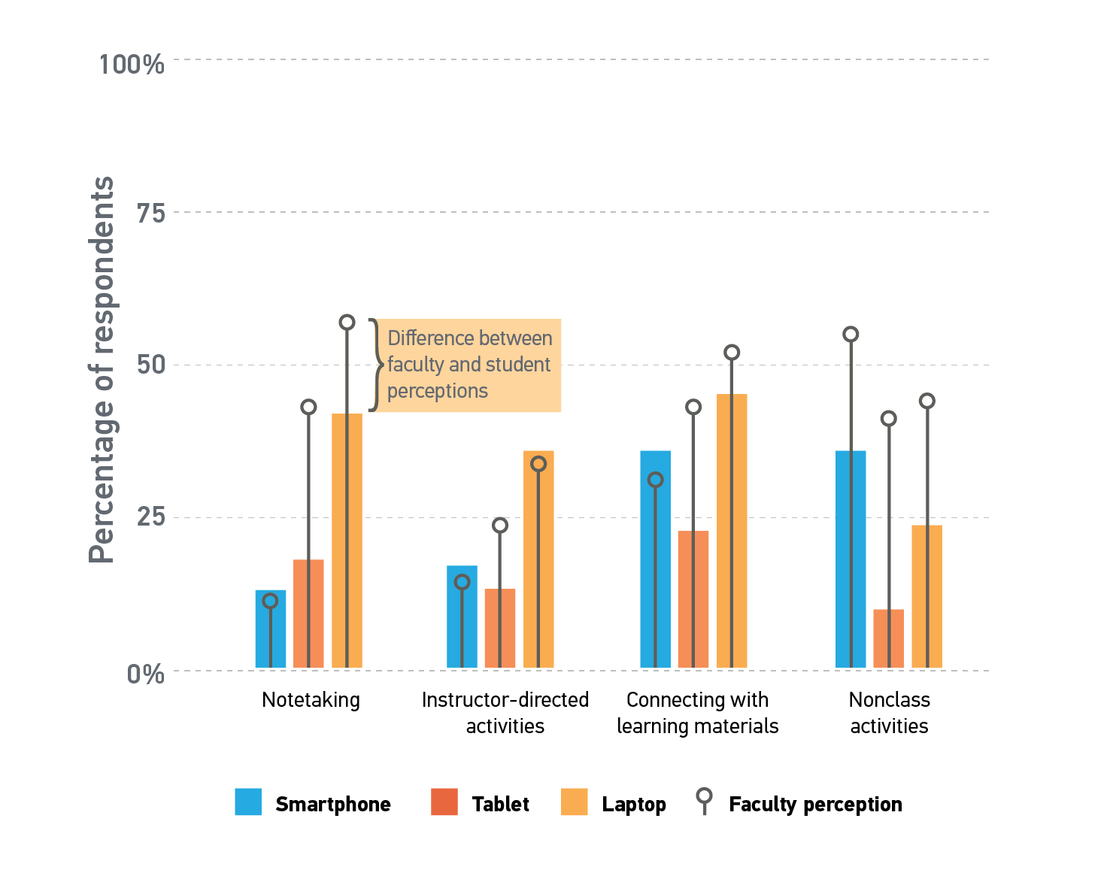
How students claim to use mobile technology in the classroom (versus faculty perceptions)

Slide 20
Questions?

Slide 21
Wireless infrastructure

Slide 22
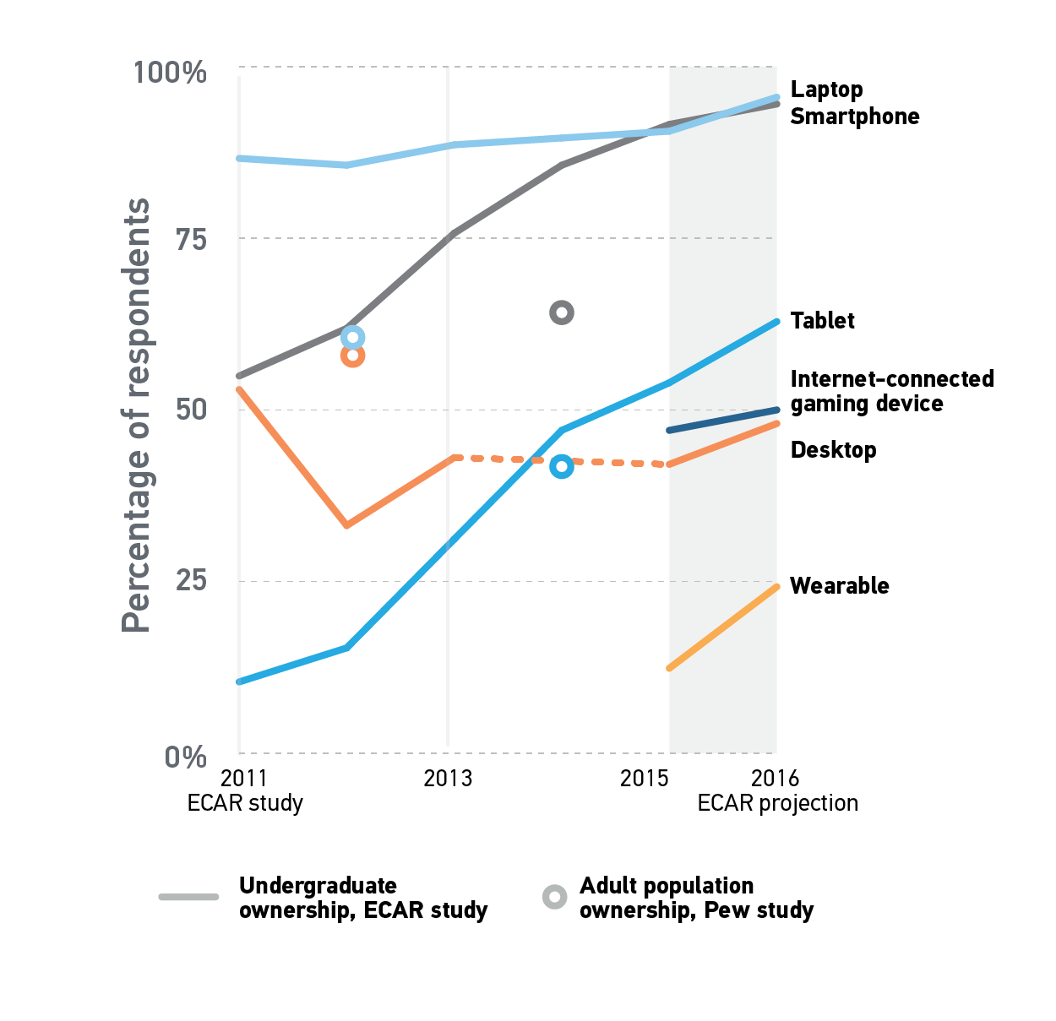
Student device ownership history, with 2016 projections

Slide 23
Poll Question 2
How many devices do your students try to connect to your network at the same time?
None
One
Two
Three or more

Slide 24
Percentage of students trying to connect devices to the network at the same time

Slide 25
Student ratings of campus network and Wi-Fi performance

Slide 26
Student ratings of campus network and Wi-Fi performance

Slide 27
Student ratings of campus network and Wi-Fi performance

Slide 28
Faculty evaluation of institutional bandwidth and data storage

Slide 29
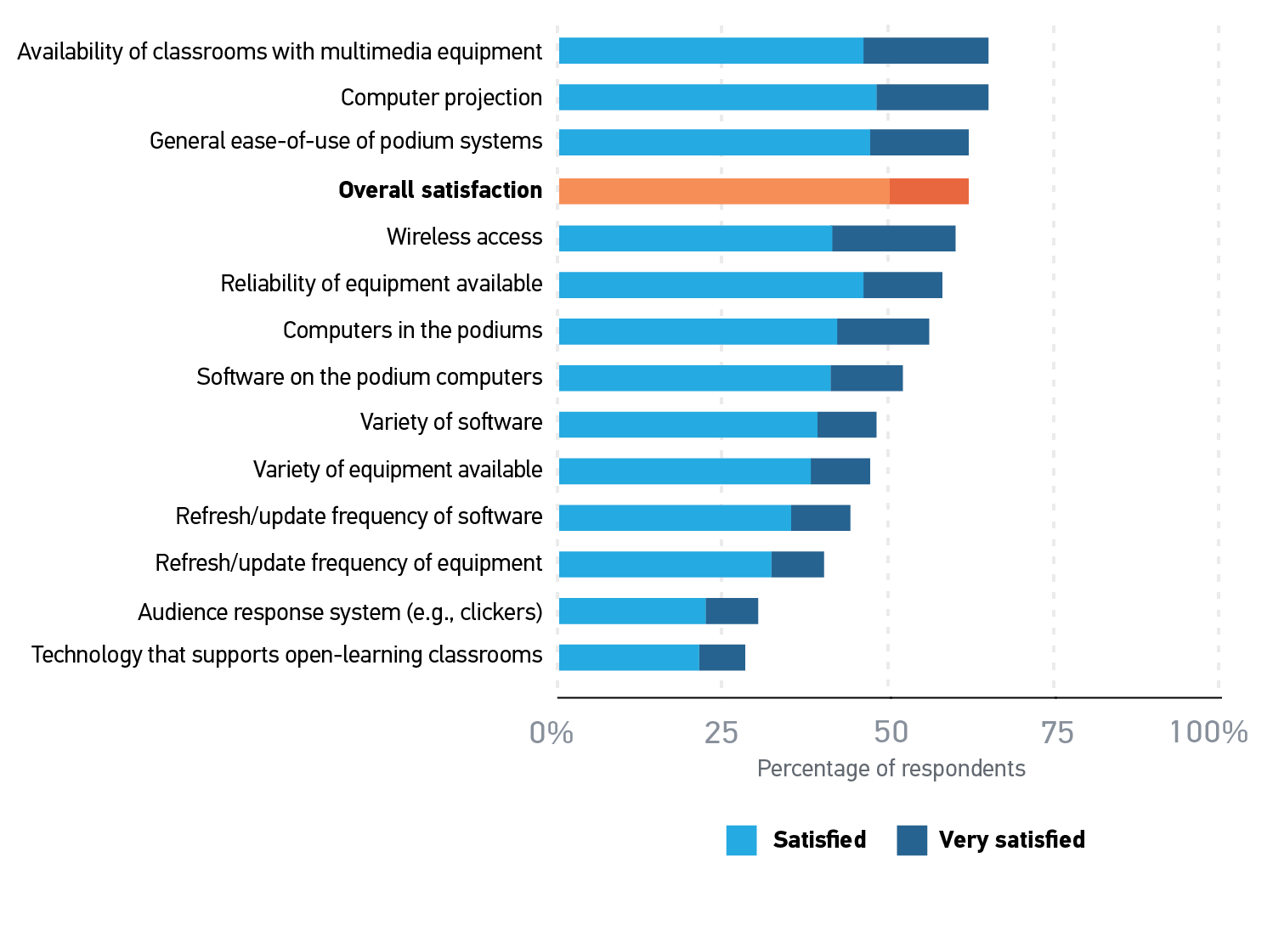
Faculty satisfaction with classroom technologies

Slide 30
Questions?

Slide 31
Analytics

Slide 32
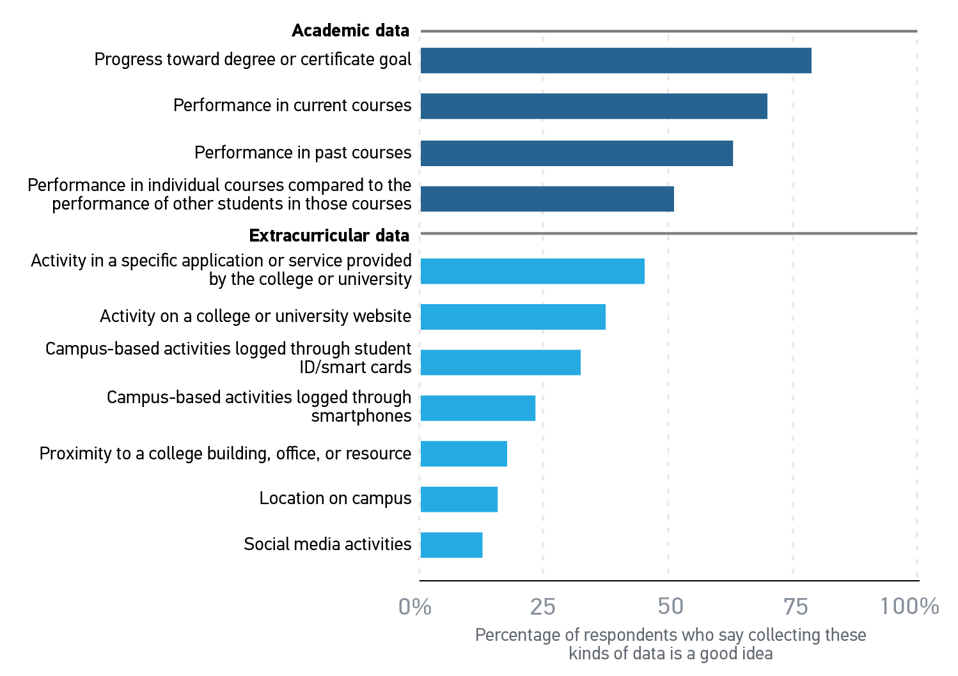
Faculty opinion about using specific types of student data

Slide 33
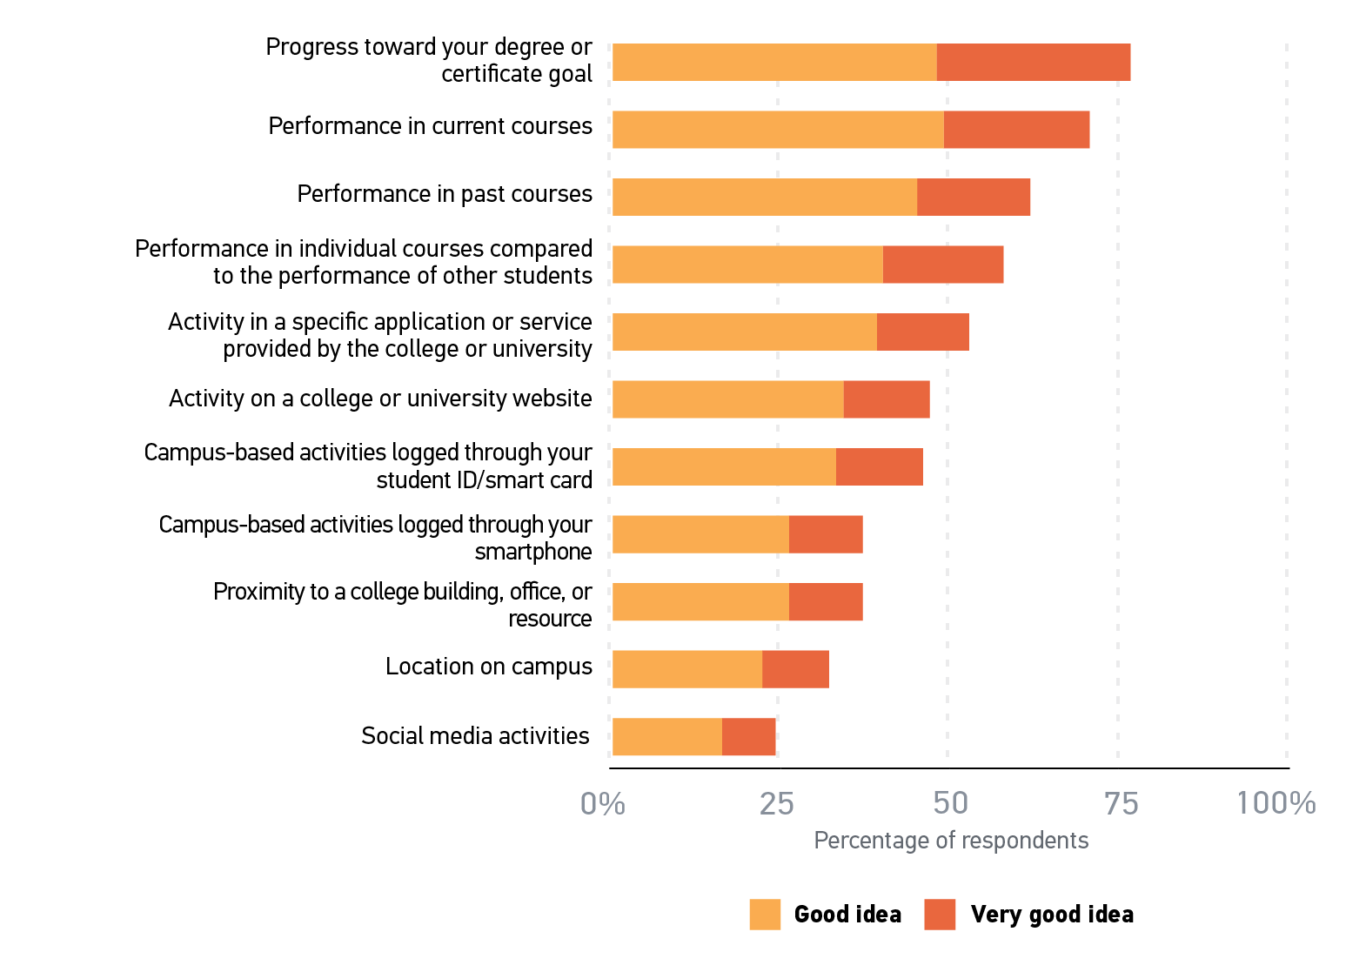
Student opinion about using specific types of student data

Slide 34
Student opinion about using specific types of student data

Slide 35
Student opinion about using specific types of student data
Helpful
“big mother”

Slide 36
Student opinion about using specific types of student data
Helpful
“big mother”
Creepy
“big brother”

Slide 37
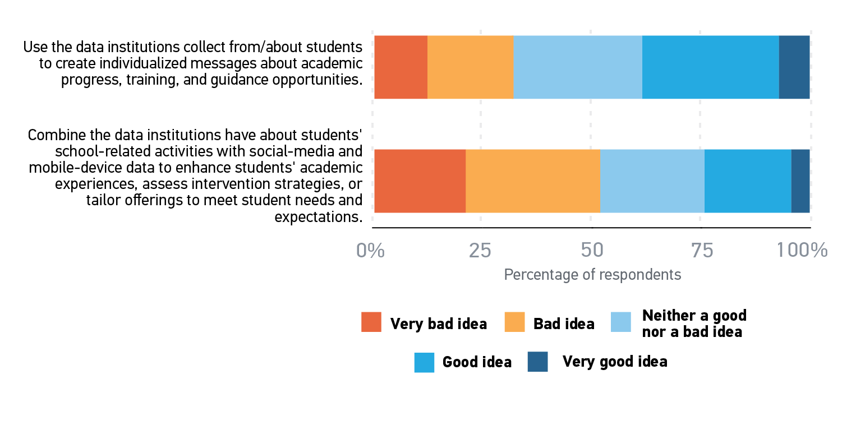
Faculty views on collecting and using student data

Slide 38
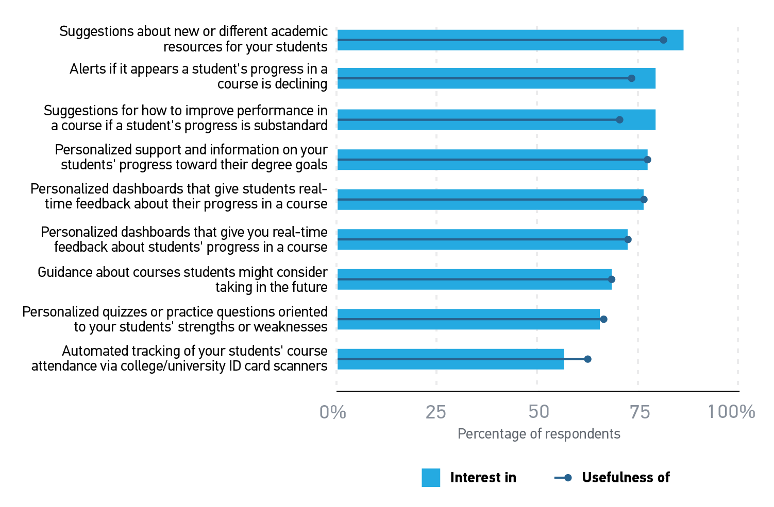
Faculty evaluation of the usefulness of interest in IPAS features

Slide 39
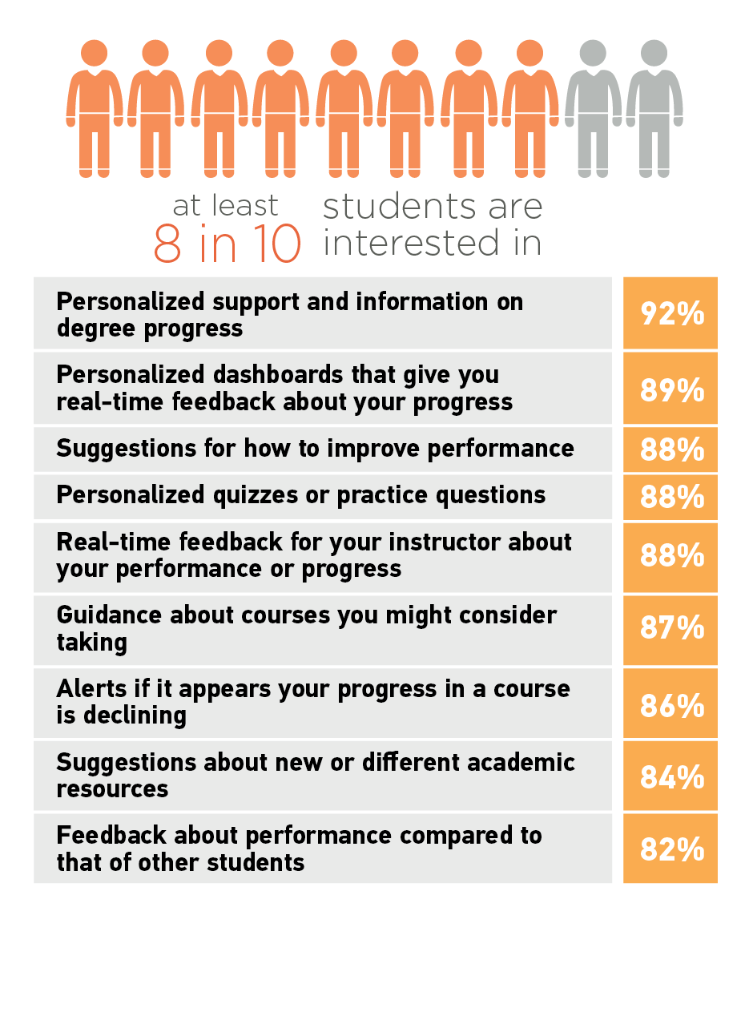
Student interest in IPAS features

Slide 40
Questions?

Slide 41
New models for education

Slide 42
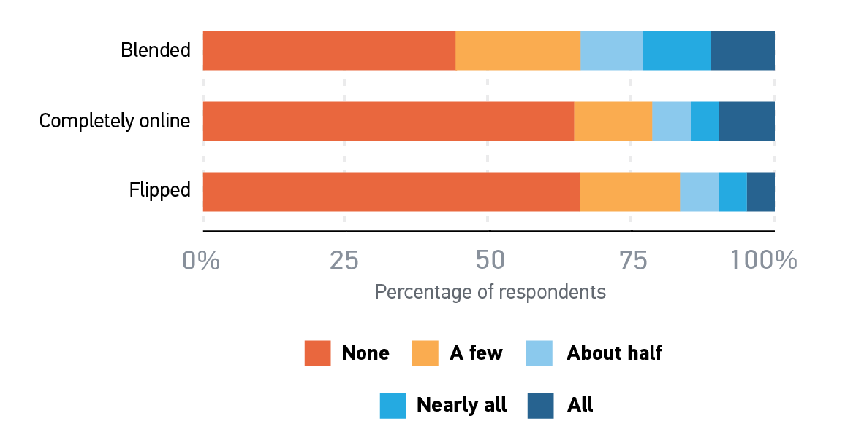
Faculty experience teaching in technology-enhanced environments

Slide 43
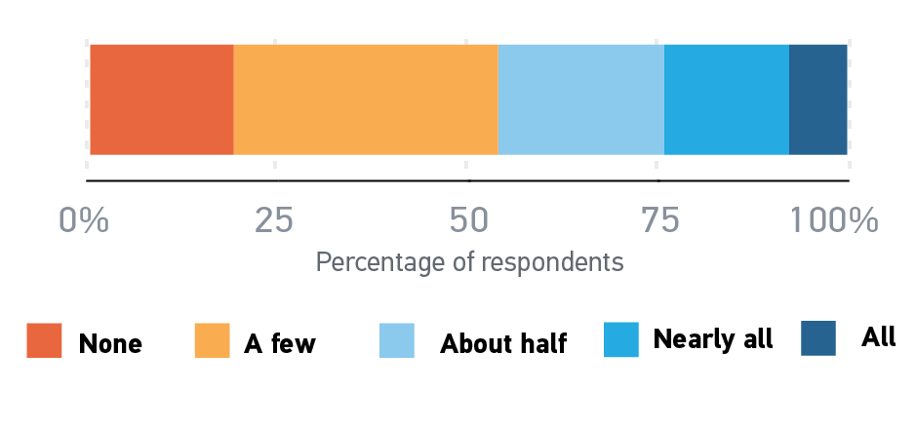
Students’ blended course experiences

Slide 44
Students’ top 5 preferences for online or face-to-face assignments and activities
Online |  | Face-to-face
Quizzes and tests | 33% | Lectures | 34%
Homework | 25% | Discussions / Q & A | 17%
Writing assignments | 12% | Quizzes and tests | 12%
Discussions, group work | 11% | Any/all activities | 11%
Paper/assignment submission | 9% | Projects/group projects | 11%

Slide 45
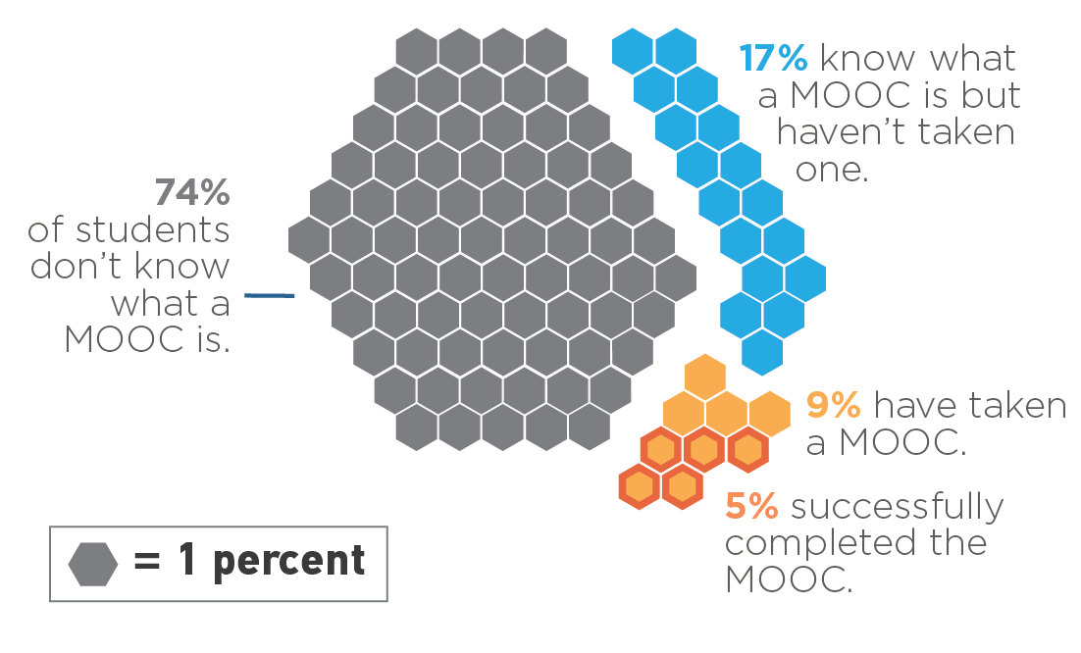
Students’ experiences with MOOCs

Slide 46
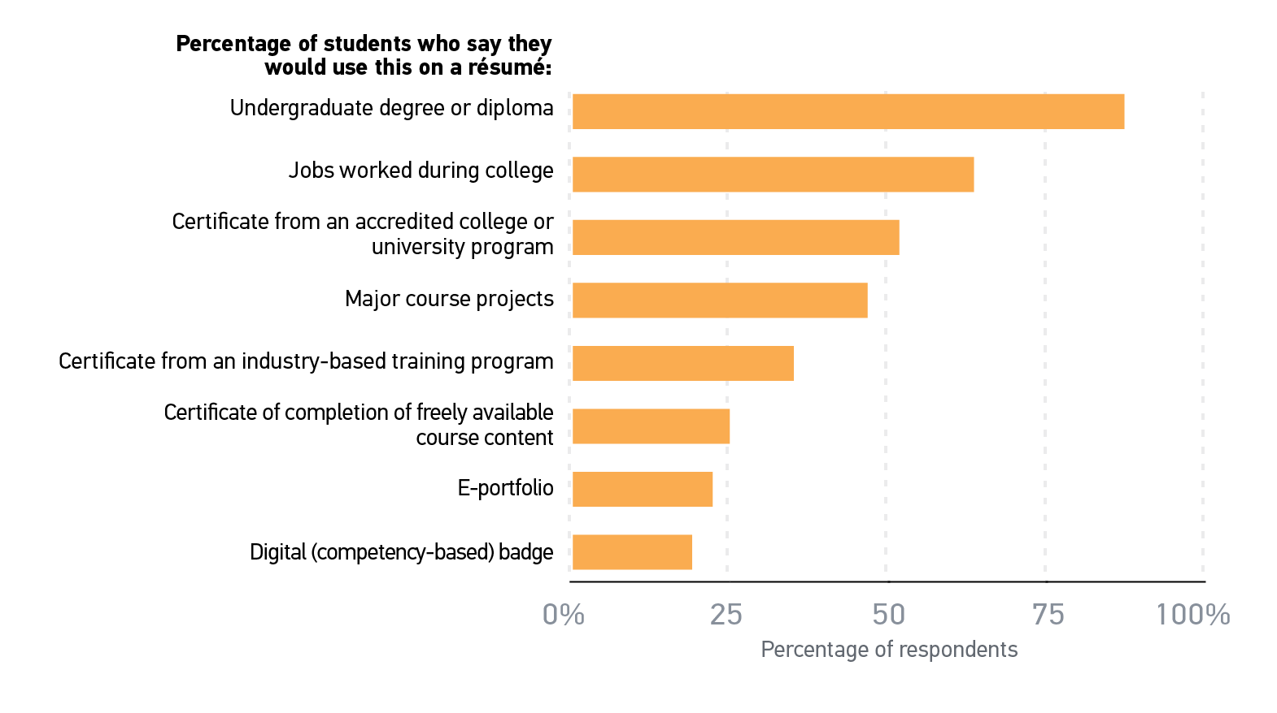
Student intent for various credentials on their résumés

Slide 47
Questions?

Slide 48
Future work

Slide 49
A series of ECAR studies that research technology experiences and expectations among students, faculty, and other populations of the academic community.

Slide 50
Get involved in this UX research
http://bit.ly/1W6iRJ6

Slide 51
Questions?

Slide 52
Thank you!
D. Christopher Brooks
cbrooks@educause.edu
@dcbphd
Eden Dahlstrom
edahlstrom@educause.edu
‪@DataDeeva

